Slide 1
Pandas Group By

Slide 2

Split, Apply, Combine pattern

Slide 3
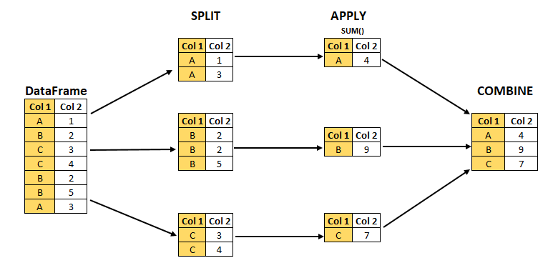
Split, Apply, Combine pattern

Slide 4
